Slide 1
USA Poverty Analysis
Using Data From the Years 2011-2021
By Sadat Gresham

Slide 2
Columns in the poverty dataset
Year (integer)
State ID (Integer)
State Name (String)
Sample size (Integer)
Number of people in poverty out of the taken sample (Integer)
Confidence level as a range (Integer)
Percentage of people in poverty (Double)
Confidence Level as a percent (Double)

Slide 3

Data Cleaning
I ensured that the data types of each Column properly represented the data within using the formula df.astype(). The amended columns are as follows:
  Year: datetime64[ns]
  Name: Category
  90% Confidence Interval: Category
  90% Confidence Interval.1: Category
There were no Columns with incorrect or missing data.

Slide 4
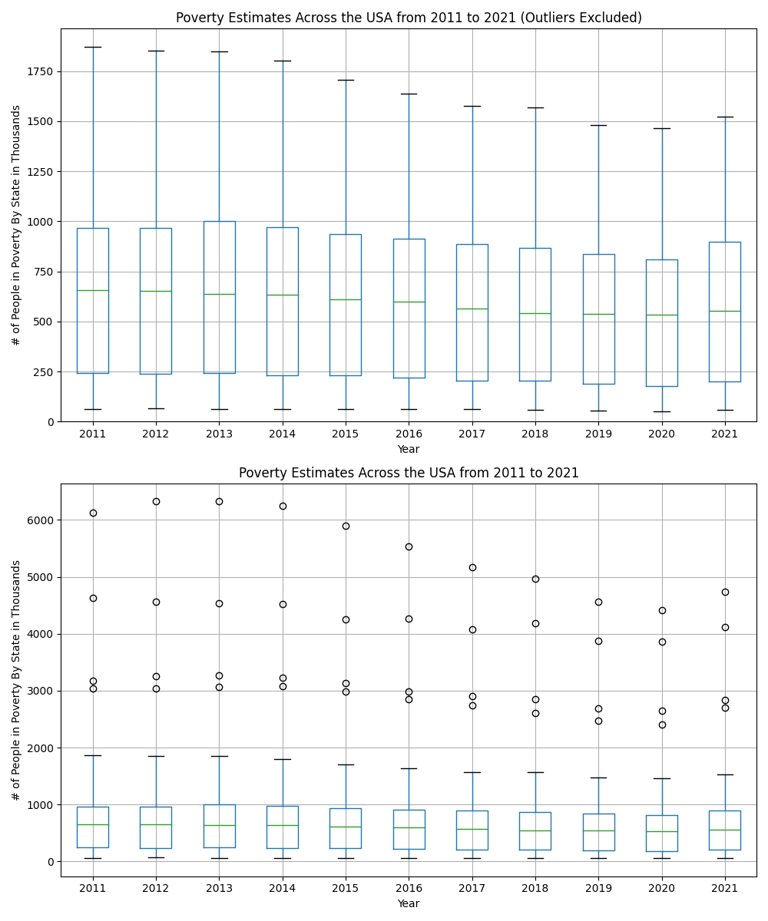
Poverty Estimates Overview
Outliers are CA, FL, NY, and TX
Box Plots are showing per-state data points for each year

Slide 5
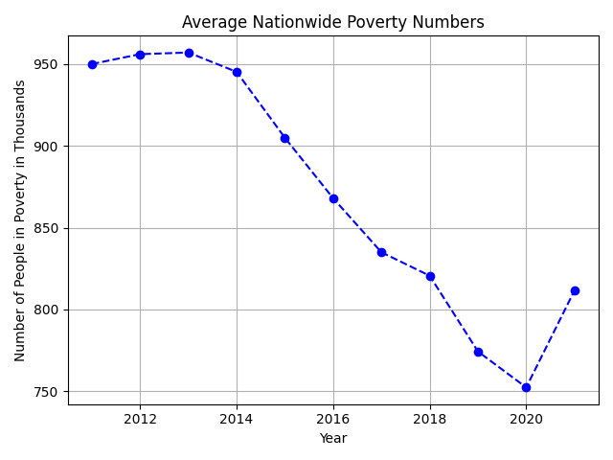
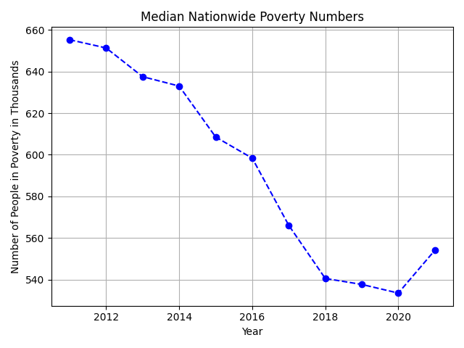
Dataset Information
Average Mean rounded to a whole number:
870,489
Average Median rounded to a whole number:
592,366

Slide 6
Hypothesis’
1: Are the Poverty Numbers more closely correlated between regions (I.E Southwest, Northeast, Midwest, etc.) or Nationwide, and why?
2: Does State Population Size affect Poverty Percentages, and why or why not?

Slide 7
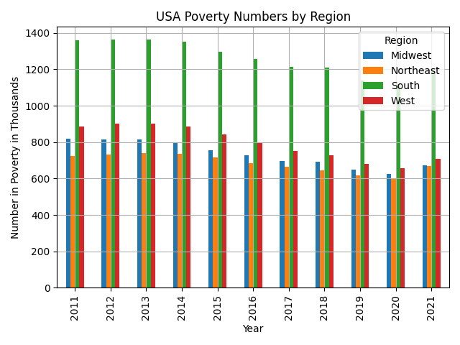
Are the Poverty Numbers more closely correlated between regions?
Every Region except for the South had poverty numbers under 1 million
  The South has two outlier states (Tx and Fl)
  Northeast and West have one outlier state each (NY and Cali)
Despite the uneven distribution of outliers, regional numbers remain similar

Slide 8
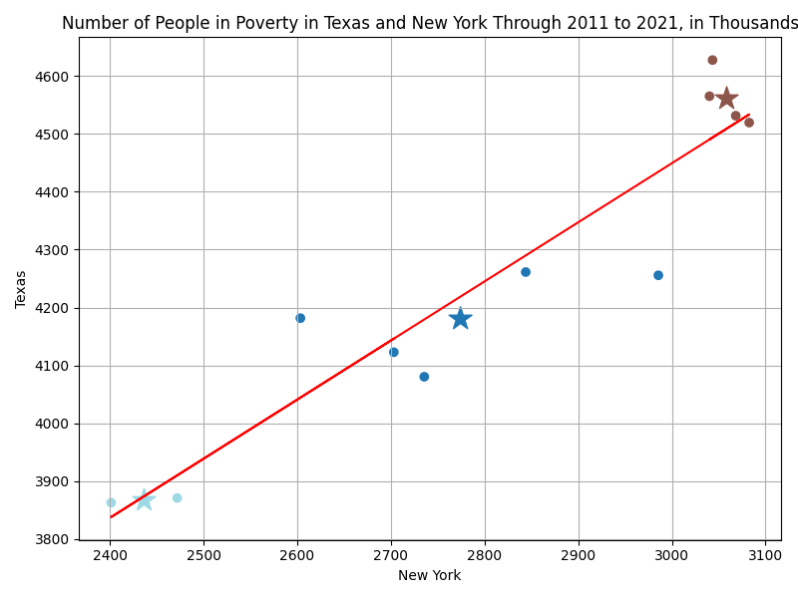
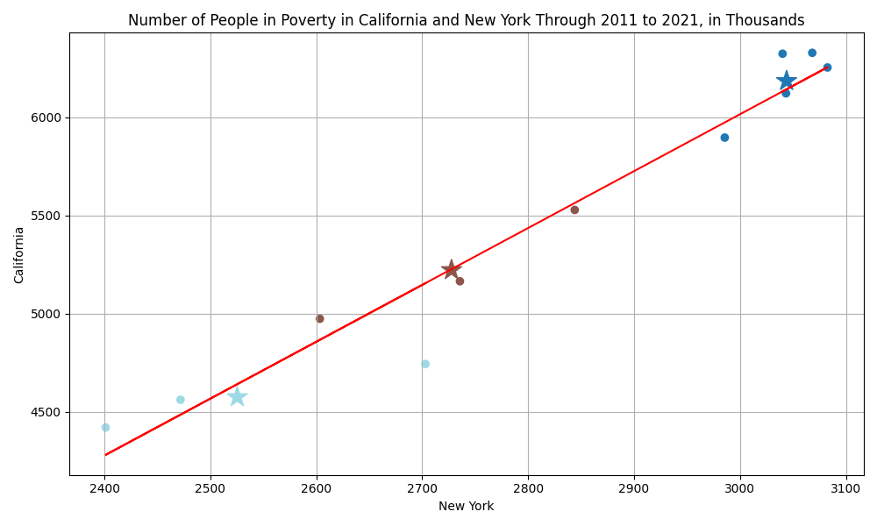
Or are the Poverty Numbers More Highly Correlated Nationwide?
Null Hypothesis
High Nationwide

Slide 9
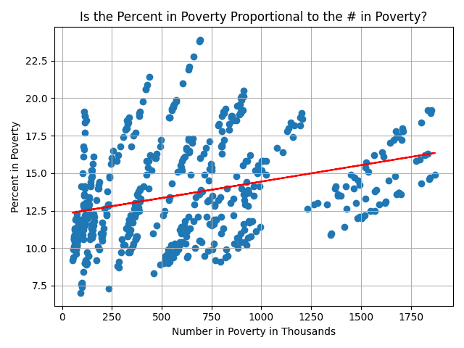
Does State Population Size affect Poverty Percentages?
Null hypothesis:
  Poverty Percentages are not affected by State Population numbers.
Positive, but Weak Correlation
  Indicates that while the hypothesis may be correct, the effect on the percentages is slight, if any at all

Slide 10
Thank You!

